Slide 1

House prices in Perth
Spiros basilakes
Thierry Zonneveld

Slide 2
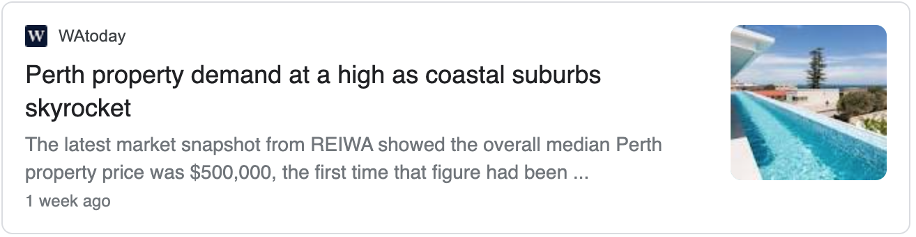
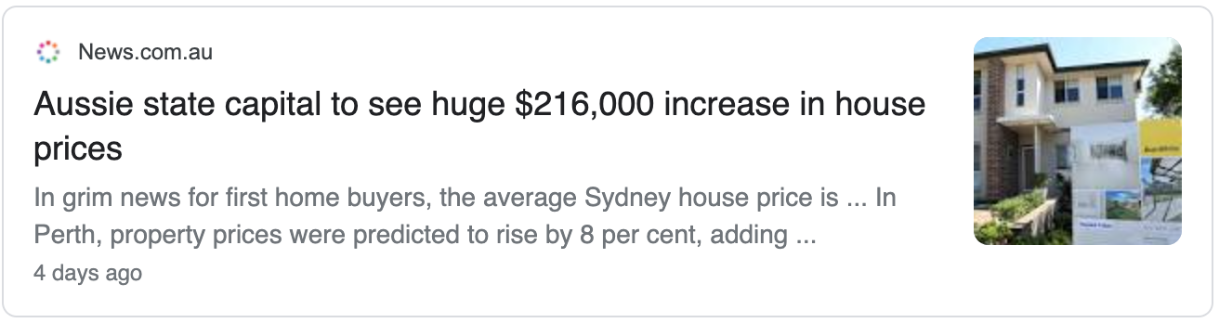
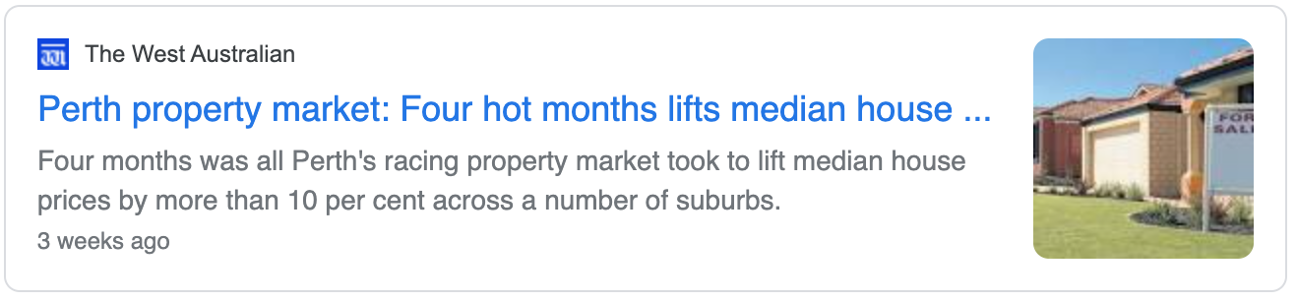


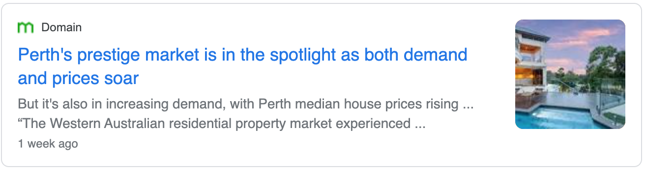
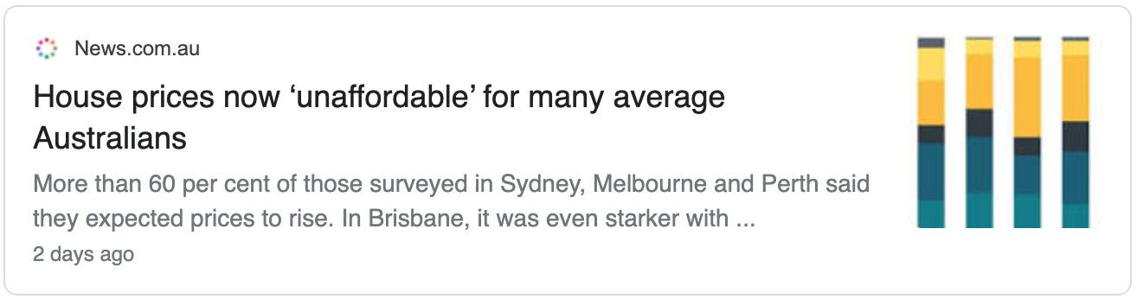
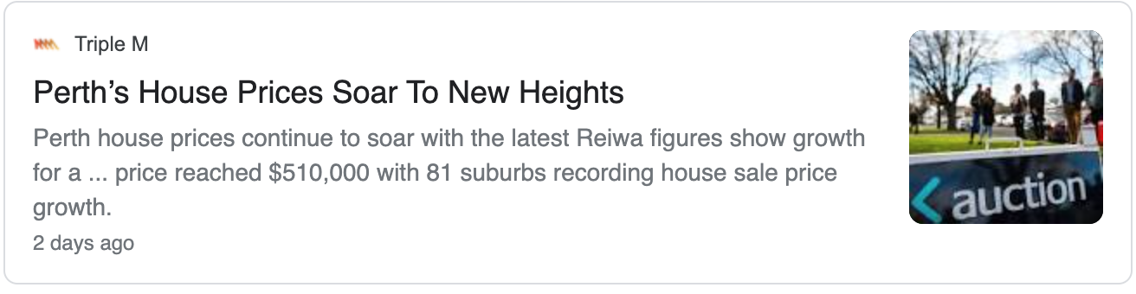
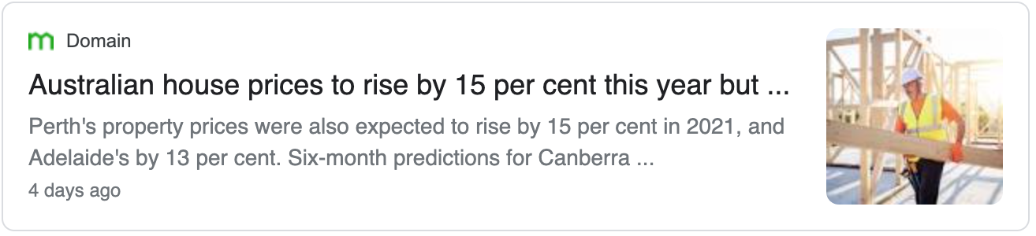
Perth house prices in the news

Slide 3
Which Perth suburb to buy a house in based on specific input parameters?

Slide 4

We will talk about:
What we set out to do
Data sources
Tools used
Methods
Result

Slide 5
What we set out to do
Find relevant house price data for the Greater Perth area
Build a dashboard to help find the location of your new house in the Greater Perth area
Build machine learning engine to train and predict based on user defined input parameters
Build and host web application

Slide 6




Data
Data used:
Perth house prices up to 31 January 2021 (https://www.kaggle.com/syuzai/perth-house-prices)
GeoJson data for WA postcodes / suburbs (https://github.com/tonywr71/GeoJson-Data)
+
+
=

Slide 7










Tools
Python Pandas
Python Seaborn
Python Scikit Learn
HTML / CSS / Bootstrap
JavaScript / Leaflet
SQL Database
Flask / SQLAlchemy
Heroku

Slide 8
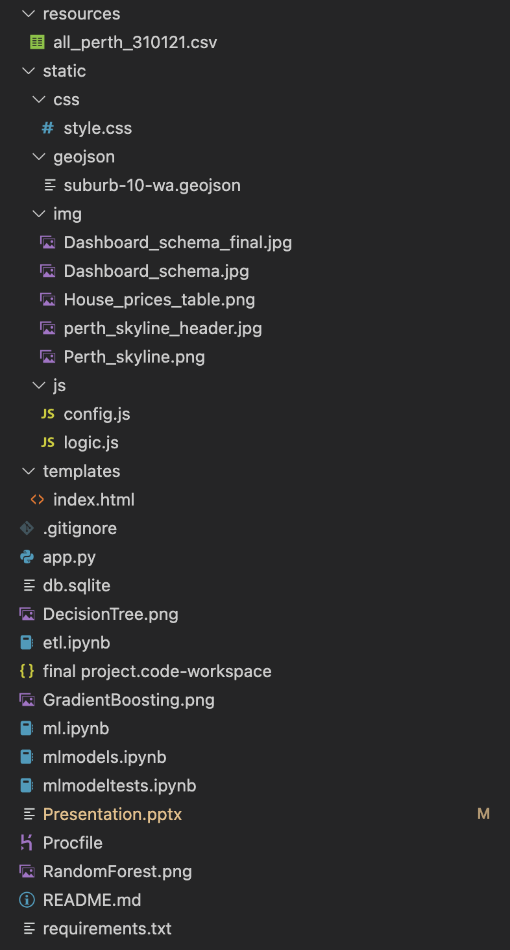
Architecture
resources
static
css
geojson
img
js
templates

Slide 9
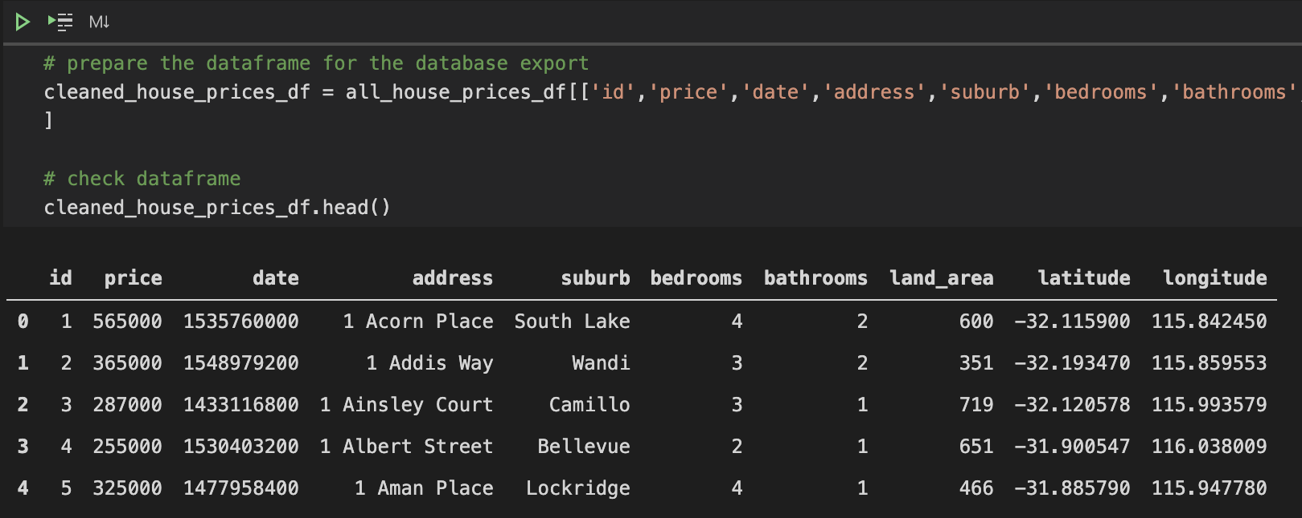
Methods – Data ETL
First step was to clean the dataset
check datatypes
removing NaN
Followed by extracting the relevant columns required for the project
Transforming columns:
add id column for primary key in database
convert date to unix format
rename columns without spaces
Load into SQLite database using SQLAlchemy

Slide 10

Machine Learning
Apply what we learned
Notes:
Looked at what we’ve been doing in class and figuring out which of the many varieties apply to our dataset and goal.

Slide 11
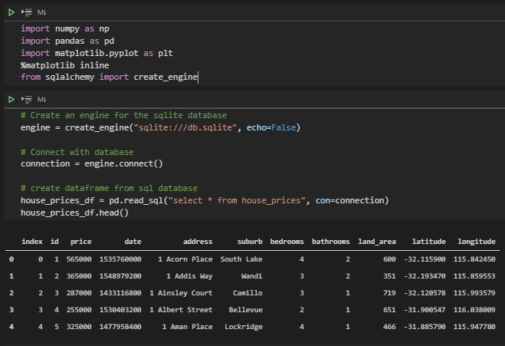
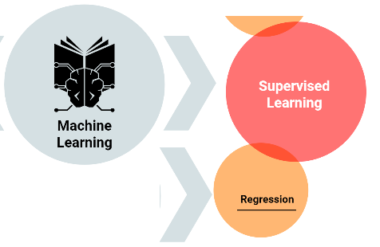
Machine Learning
Linear Regression
Boilerplate code!
Notes:
Supervised Learning => Linear regression
Of course boilerplate code!

Slide 12
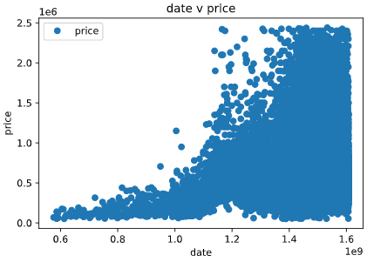
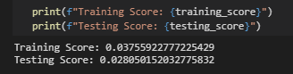

Machine Learning
Progress!
Notes:
Looking at data:
-Scatterplots indicate linearity

Slide 13
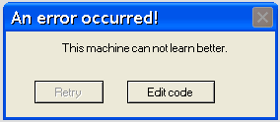
Machine Learning
Stuck ☹
Notes:
Couldn’t:
-Increase accuracy
-Export model
What can we do? What did others do?

Slide 14
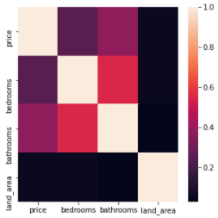

Machine Learning
Progress!
Notes:
Looking at other’s methods & data:
-Check for multicollinearity: None! - variables do not interfere with correlations
-Support for linear regression, on top of using numerical data to predict numerical data
-More models!

Slide 15

Machine Learning
Decision Tree
Random Forest
Gradient Boosting Machines
Notes:
Couldn’t:
-Increase accuracy
-Export model
What can we do? What did others do?

Slide 16
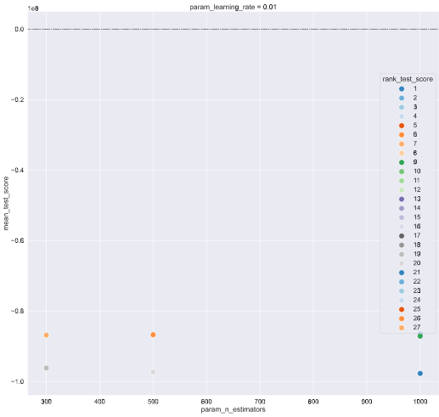
Machine Learning
NRMSE not good enough!
Notes:
Manipulating variables did not increase accuracy

Slide 17
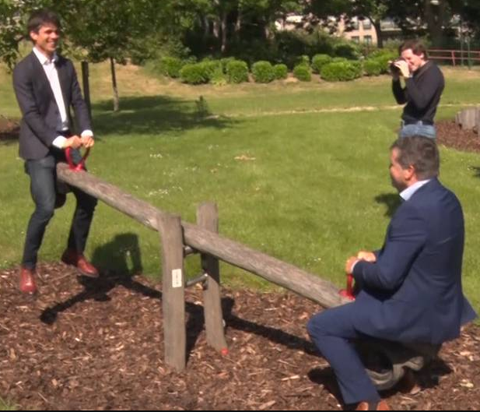
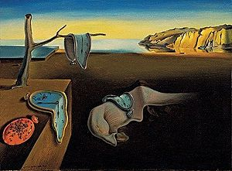

Machine Learning
Models work!
Notes:
Models work but huge trade off between quickness and complexity & accuracy

Slide 18
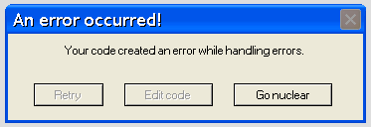
Machine Learning
Stuck ☹
Notes:
Could not progress from here.

Slide 19

Machine Learning
Stuck ☹
Notes:
Realised we needed to revise last few steps to better apply concept of ML:
-Further manipulate dataset to input expected outcomes LR, which improves training and testing, and predictions
-Match predictions based on website input variables to allow for LR to give maximum # of hits

Slide 20
Methods – Web Application
Using Flask-SQLAlchemy the database was made accessible for the web application
HTML, CSS and Bootstrap used for the web page and styles
HTML input forms used to filter the data from the database
Prepare map and read in the GeoJson and Jsonified results into the logic.js
Apply machine learning model on the results for the selected month in the future
Use the Chloropleth library to show the number of hits per suburb on a colour scale

Slide 21
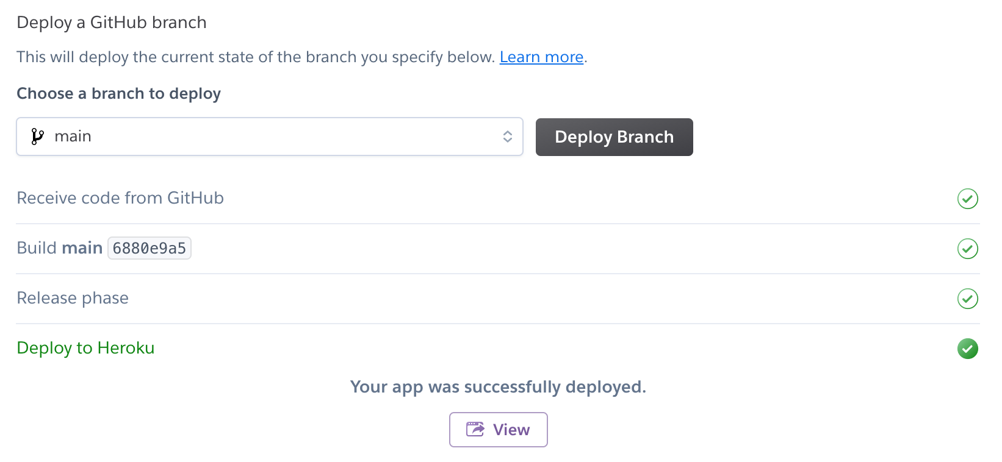

Methods – Web Deployment
Deployment using Heroku:
requirements.txt
Procfile

Slide 22
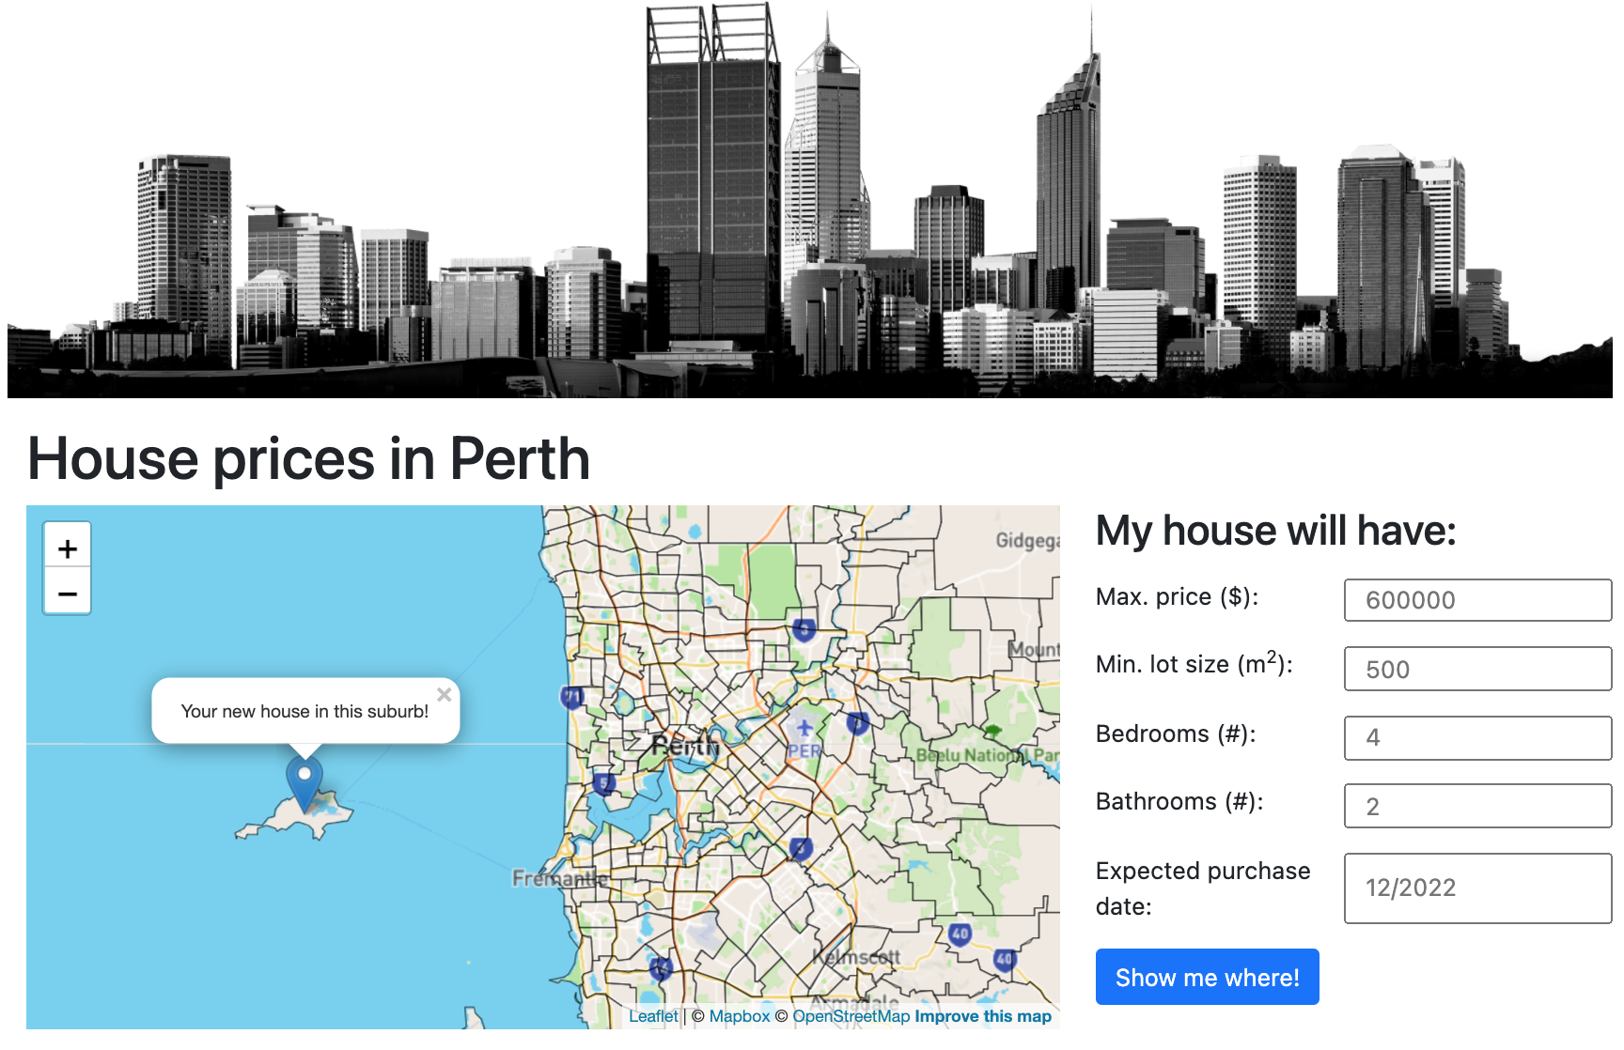
Result

Slide 23
At least we didn’t use pie charts.
- Spiros basilakes & Thierry zonneveld

